Slide 1
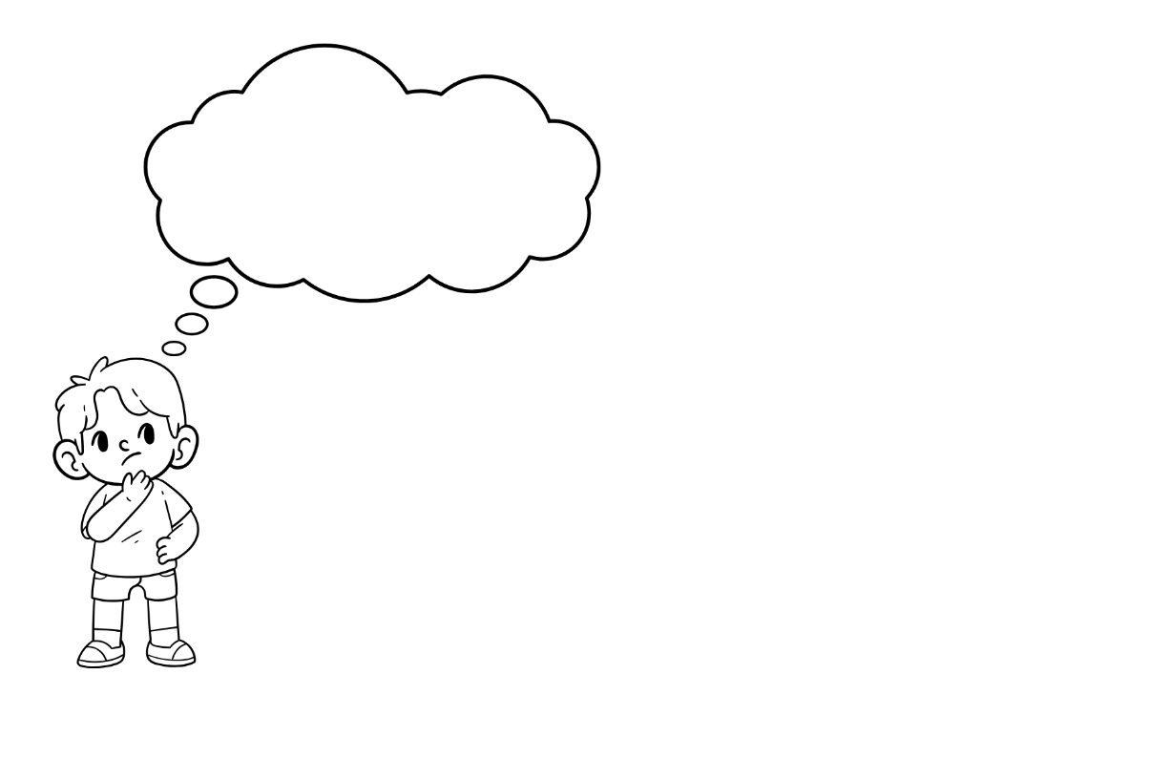
WELCOME
While waiting for assembly to begin have a think of one thing you are thankful for

Slide 2
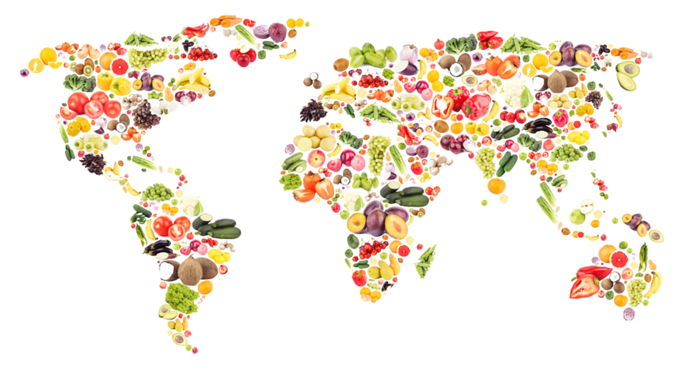


WHAT IS MEANT BY THE WORD HARVEST
Article 24 (health and health services) Every child has the right to the best possible health. Governments must provide good quality health care, clean water, nutritious food, and a clean environment and education on health and well-being so that children can stay healthy. Richer countries must help poorer countries achieve this.

Slide 3

A celebration of the food that is grown on the land
A time to say thank you for the food we have
A chance to give back to the community
Did you know?
In ancient times, Harvest festivals were the biggest celebrations of the year!
HARVEST IS …

Slide 4
IS THERE ENOUGH FOOD
Is there enough food in the world to go around?
Over 673 million people in the world don’t have enough to eat every day
Notes:
The most recent UN/FAO estimates (2024 data, published 2025) suggest: About 673 million people experience hunger worldwide [data.unicef.org], [who.int]
With a range estimate of around 638–720 million people

Slide 5
IS THERE ENOUGH FOOD
The world can provide food to feed twice its current population, but many people still go hungry!
Food waste – it's estimated that a third of the world’s food is wasted, which is enough to feed 1.26 billion people
Lack of access - due to factors like food shortages, conflict and climate change

Slide 6

When you think about people experiencing hunger, which parts of the world come to mind first?

Slide 7
Around 13 million people live below the poverty line in the UK
More than 4.5 million children live in poverty in the UK
1 in 4 parents in the UK missed a meal to feed their children
GUESS WHAT …

Slide 8
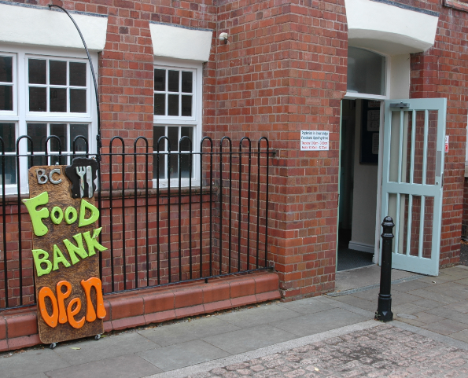
WHAT DO YOU THINK A FOOD BANK IS
A food bank is a place where food is given free of charge to people in need
Food banks are usually run by charities and staffed by volunteers
It is not known how many food banks there are, but what we do know is that sadly there are more food banks in the UK than there are McDonald's!

Slide 9
What does Black Country Foodbank do?
https://vimeo.com/1107661517

Slide 10
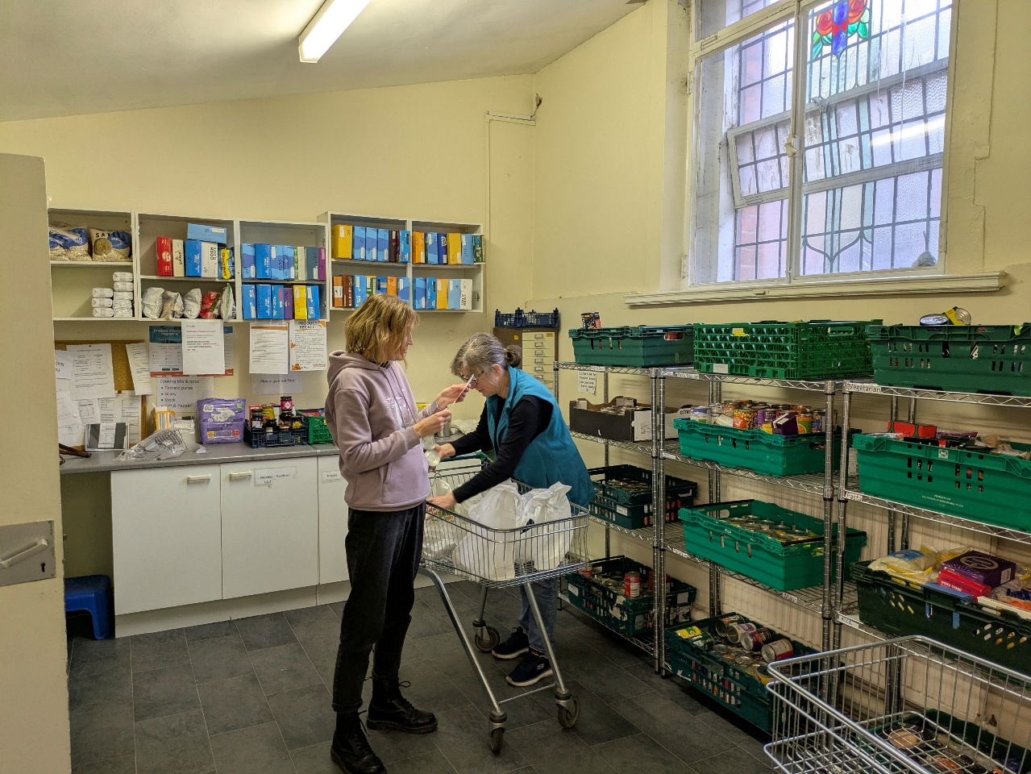

IN 2025 …
We provided nearly ½ million meals = that’s the equivalent of handing out 1 bag of pasta every minute!
We provided 52 meals every hour
We supported 14,628 children

Slide 11
TAKE A MOMENT TO THINK …
What if your family didn't have enough food for dinner tonight?
How would it feel if someone helped you when you needed it most?
You Can Make a Difference!
Donate an item for the Harvest collection
Ask your family to buy one extra item when shopping
Be kind and help others in your community
Remember... Small acts of kindness can make a BIG difference

Slide 12

THANK YOU

