Slide 1
While waiting for assembly to begin have a think of one thing you are thankful for

Slide 2
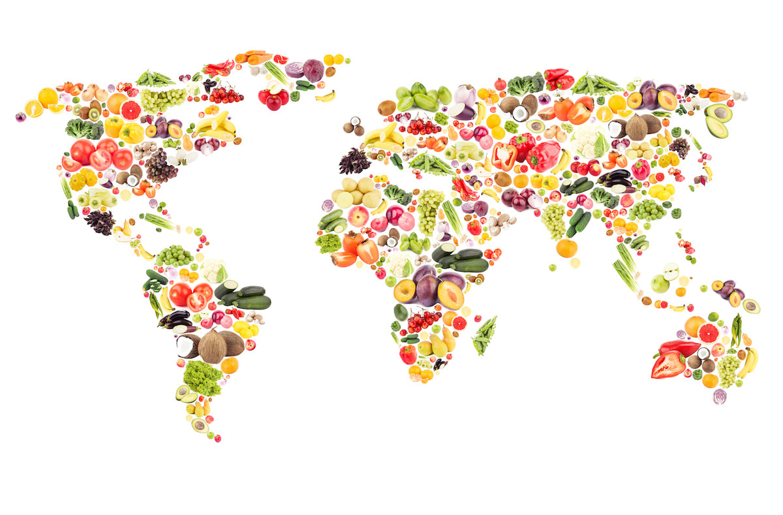
What is meant by the word?
HARVEST
Article 24 (health and health services) Every child has the right to the best possible health. Governments must provide good quality health care, clean water, nutritious food, and a clean environment and education on health and well-being so that children can stay healthy. Richer countries must help poorer countries achieve this.

Slide 3
HARVEST
Harvest is a celebration of the food that is grown on the land.
Harvest time is all about celebrating all the good things the earth supplies.
In Britain, Harvest is often celebrated in churches and schools by bringing baskets of food to give thanks to God.

Slide 4
Is there enough food in the world to go around?

Slide 5
The world can provide food to feed twice its current population, but many people still go hungry due to …
1. Food waste – its estimated that 1/3 of the world’s food is wasted, which is enough to feed 1.26 billion people.
2. Lack of access - due to factors like food shortages, conflict and climate change.

Slide 6
When you think of people going hungry where in the world do you see it happening?

Slide 7
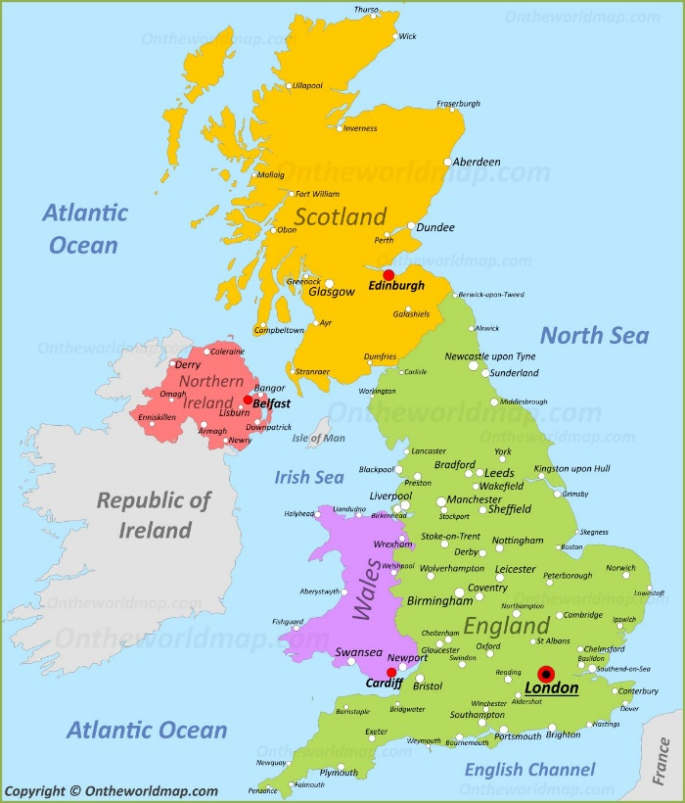
Do we experience real hunger in the UK?
Article 24 (health and health services) Every child has the right to the best possible health. Governments must provide good quality health care, clean water, nutritious food, and a clean environment and education on health and well-being so that children can stay healthy. Richer countries must help poorer countries achieve this.

Slide 8
Guess what?
Over 13 million live below the poverty line in the UK.
1 in 5 parents missed a meal to feed their children
Millions of food parcels were given out last year in the UK.

Slide 10
What do you think a foodbank is?
A foodbank is a place where food is given free of charge to people in need
Foodbanks are usually run by charities and staffed by volunteers
It is not known how many foodbanks there are but what we do know is that is sadly there are more foodbanks in the UK than there are Mc Donald's!!!

Slide 11
What does Black Country Foodbank do?

Slide 12
Why might someone need an emergency food parcel?

Slide 13
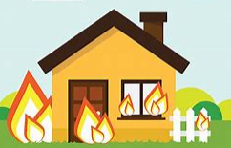
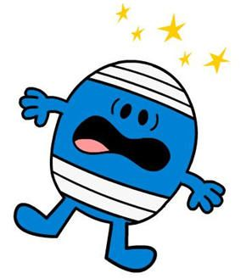
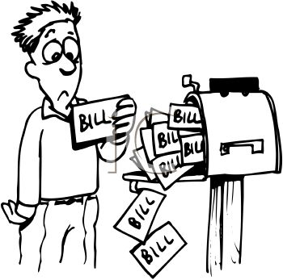
Homelessness
Fire
Sickness
Bills
Why do people need a foodbank?
Lost job
Theft
Low income

Slide 14
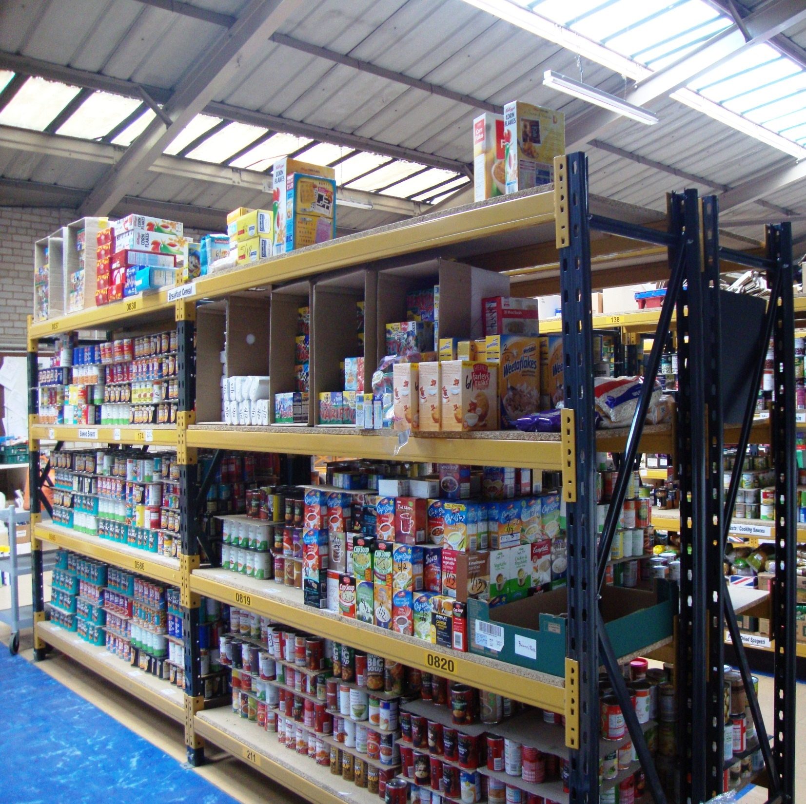
In 2023
It was the first year we distributed over ½ million meals.
63 meals were provided every hour.
24% increase in children supported by foodbank.
49% increase in children accessing foodbank in the summer holidays.

Slide 15
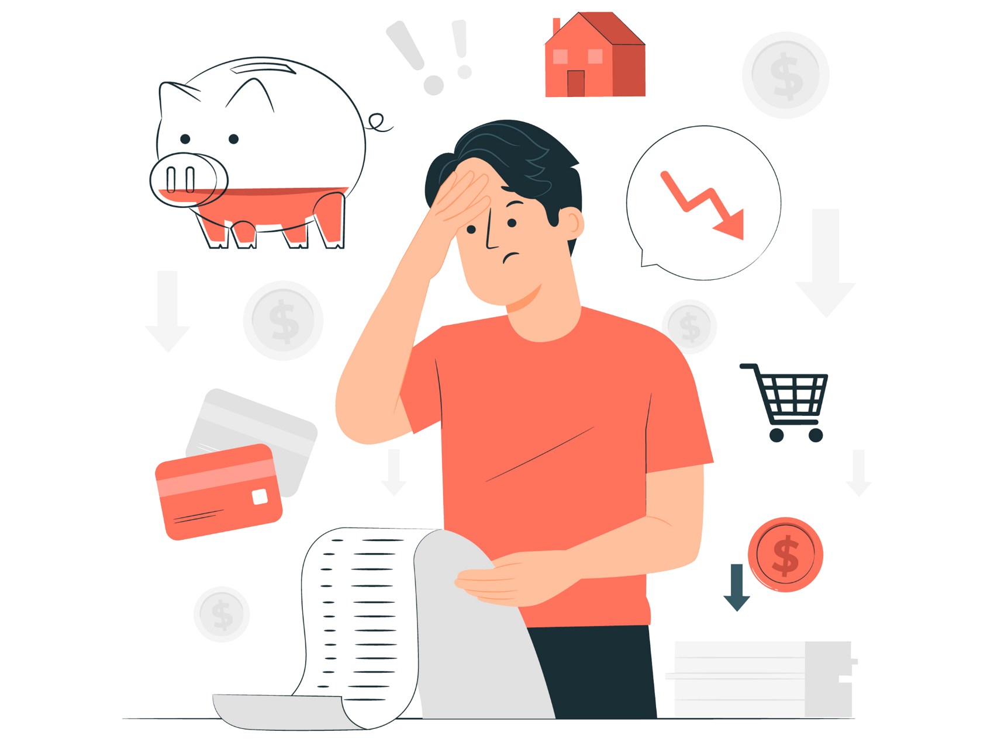
We can all play our part
Every little helps…

