Slide 1
While waiting for assembly to begin have a think of one thing you are thankful for.

Slide 2
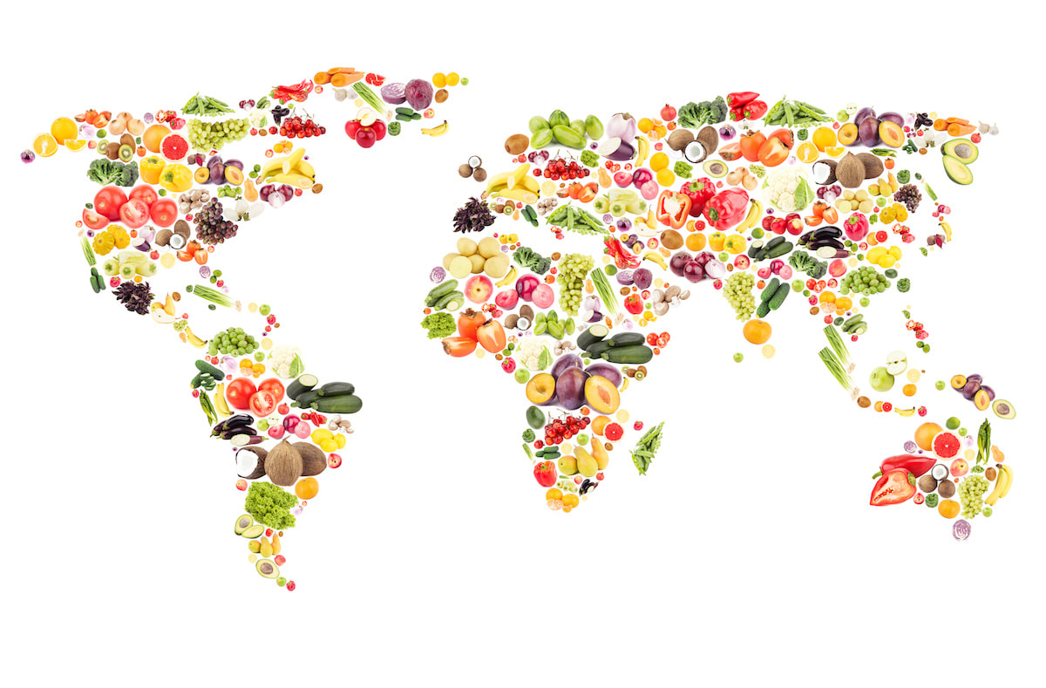
What is meant by the word?
HARVEST
Article 24 (health and health services) Every child has the right to the best possible health. Governments must provide good quality health care, clean water, nutritious food, and a clean environment and education on health and well-being so that children can stay healthy. Richer countries must help poorer countries achieve this.

Slide 3
HARVEST
Harvest is a celebration of the food that is grown on the land.
Harvest time is all about celebrating all the good things the earth supplies.
In Britain, Harvest is often celebrated in churches and schools by bringing baskets of food to give thanks to God.

Slide 4
Is there enough food in the world to go around?

Slide 5
“The world can provide food to feed twice its current population. Therefore, in a world overflowing with riches,

Slide 6
When you think of people going hungry where in the world do you see it happening?

Slide 7
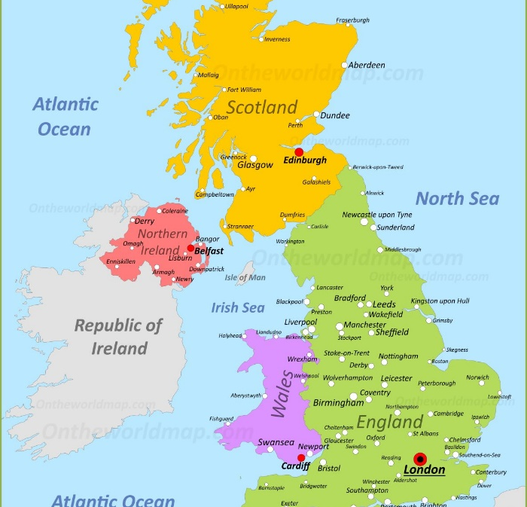
Do we experience real hunger in the UK?
Article 24 (health and health services) Every child has the right to the best possible health. Governments must provide good quality health care, clean water, nutritious food, and a clean environment and education on health and well-being so that children can stay healthy. Richer countries must help poorer countries achieve this.

Slide 8
Guess what?
Over 13 million live below the poverty line in the UK.
1 in 5 parents missed a meal to feed their children
Millions of food parcels were given out last year in the UK.

Slide 10
What do you think a food bank is?
A food bank is a place where food is given free of charge to people in
need
Foodbanks are usually run by charities and staffed by volunteers
It is not known how many food banks there are
but what we do know is that is sadly there are more foodbanks in the UK than there are Mc Donald's!!!

Slide 11
What does Black Country Foodbank do?

Slide 12
Why might someone need an emergency food parcel?

Slide 13
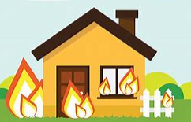
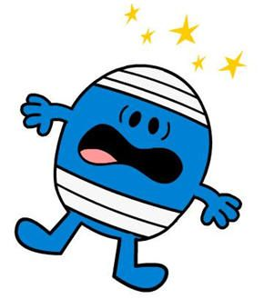
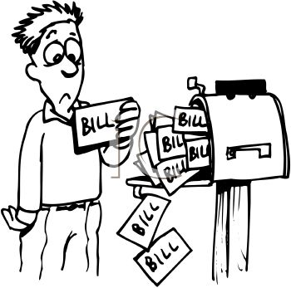
Homelessness
Fire
Sickness
Bills
Why do people need foodbank?
Lost job
Theft
Low income

Slide 14
A Year of Firsts!

Slide 15
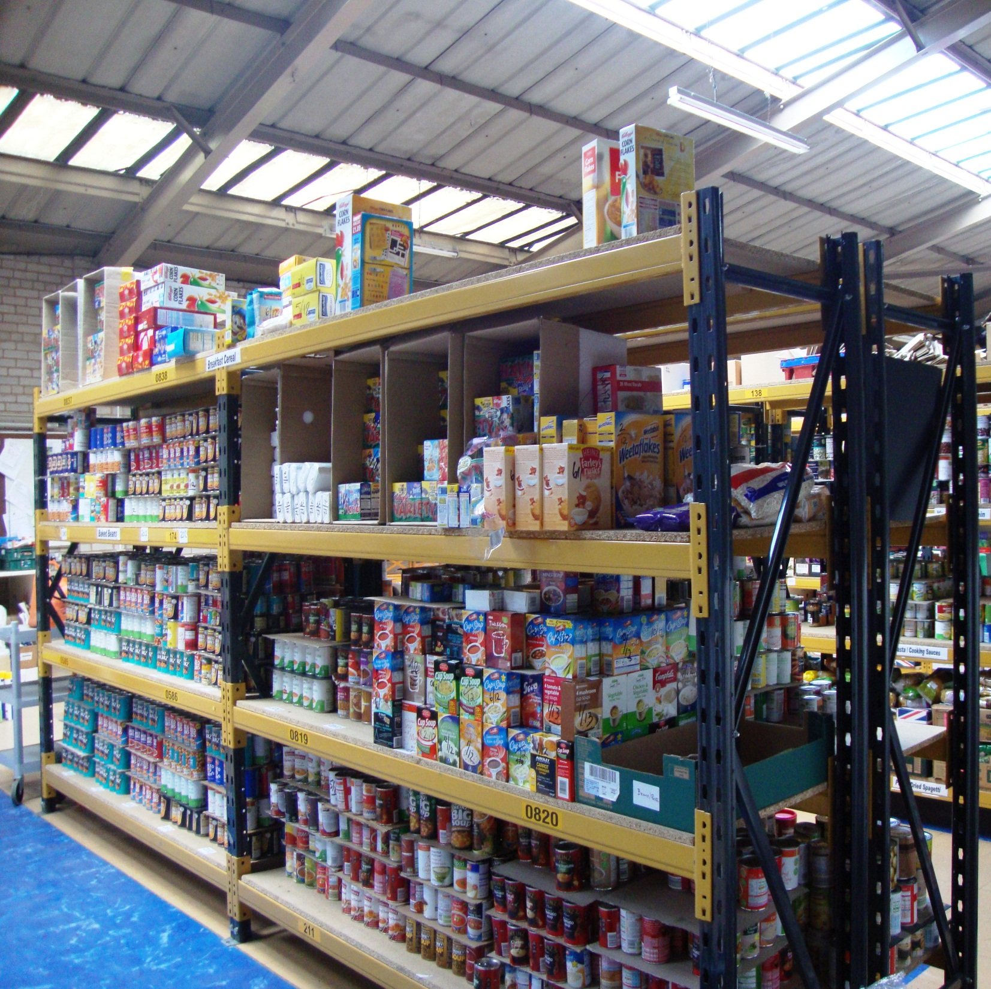
st
#
It was the first year we distributed over ½ million meals!
It was the first year we provided over 200 tonnes of food ( which is the same weight as 30 elephants.
It was the first year we supported more than
10,000 children!

Slide 16
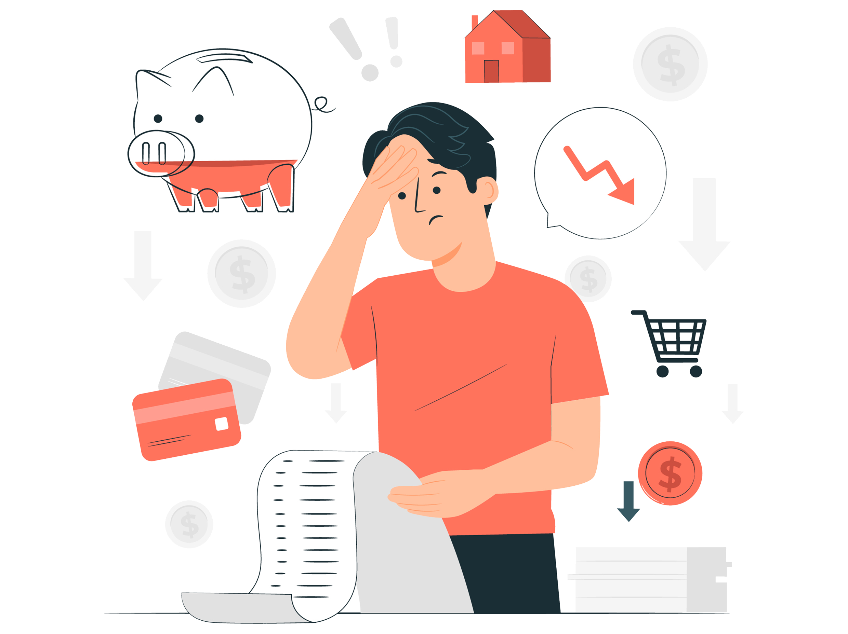
We can all play our part
Every little helps…

